Slide 1

CST 205 OOP-INTERFACES ,OBJECT STREAMS AND SERIALIZATION
Sit Dolor Amet

Slide 2
OBJECTIVES
To explain about interfaces
To give an overview of accessing interface
Implementation of interfaces
Interface vs class.
Object stream and serialization

Slide 3
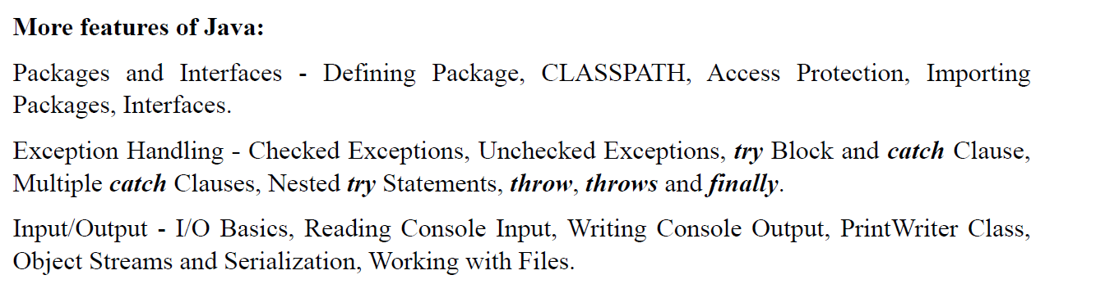

Slide 4
INTERFACES
Interfaces are syntactically similar to classes, but they lack instance variables, and their methods are declared without any body.
Once it is defined, any number of classes can implement an interface.
Also, one class can implement any number of interfaces.
To implement an interface, a class must create the complete set of methods defined by the interface. However, each class is free to determine the details of its own implementation.
By providing the interface keyword, Java allows you to fully utilize the “one interface,multiple methods” aspect of polymorphism.
Interfaces are designed to support dynamic method resolution at run time.

Slide 5
INTERFACES
You cannot instantiate an interface.
An interface does not contain any constructors.
All of the methods in an interface are abstract.
An interface cannot contain instance fields. The only fields that can appear in an interface must be declared both static and final.
An interface is not extended by a class; it is implemented by a class.
An interface can extend multiple interfaces.

Slide 6
INTERFACES
It is a collection of abstract methods. A class implements an interface, thereby inheriting the abstract methods of the interface.
An interface contains behaviors that a class implements.
An interface is similar to a class in the following ways −
An interface can contain any number of methods.
An interface is written in a file with a .java extension, with the name of the interface matching the name of the file.
The byte code of an interface appears in a .class file.
Interfaces appear in packages, and their corresponding bytecode file must be in a directory structure that matches the package name.

Slide 7
INTERFACES VS CLASSES
BASIS FOR COMPARISON | CLASS | INTERFACE
Basic | A class is instantiated to create objects. | An interface can never be instantiated as the methods are unable to perform any action on invoking.
Keyword | class | interface
Access specifier | The members of a class can be private, public or protected. | The members of an interface are always public.
Methods | The methods of a class are defined to perform a specific action. | The methods in an interface are purely abstract.
Implement/Extend | A class can implement any number of interface and can extend only one class. | An interface can extend multiple interfaces but can not implement any interface.
Constructor | A class can have constructors to initialize the variables. | An interface can never have a constructor as there is hardly any variable to initialize.

Slide 8
In general terms, an interface can be defined as a container that stores the signatures of the methods to be implemented in the code segment

Slide 9
Defining an Interface
An interface is defined much like a class. This is the general form of an interface:
access interface name {
return-type method-name1(parameter-list);
return-type method-name2(parameter-list);
type final-varname1 = value;
type final-varname2 = value;
// ...
return-type method-nameN(parameter-list);
type final-varnameN = value;
}

Slide 10
Defining an Interface
When no access specifier is included, then default access results, and the interface is only available to other members of the package in which it is declared.
When it is declared as public, the interface can be used by any other code.
In this case, the interface must be the only public interface declared in the file, and the file must have the same name as the interface. name is the name of the interface, and can be any valid identifier.
Notice that the methods that are declared have no bodies. They end with a semicolon after the parameter list.
They are, essentially, abstract methods; there can be no default implementation of any method specified within an interface. Each class that includes an interface must implement all of the methods.

Slide 11
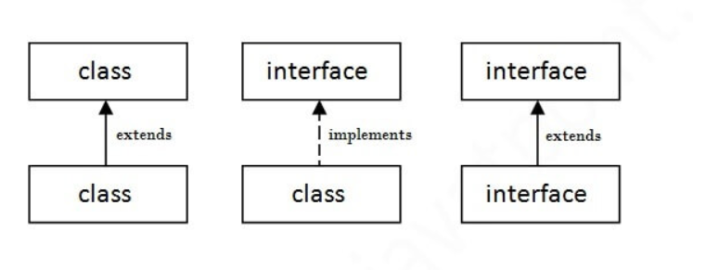
The relationship between classes and interfaces

Slide 12
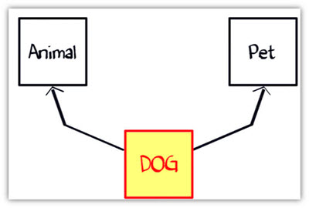
Why is an Interface required?
Suppose you have a requirement where class "dog" inheriting class "animal" and "Pet" (see image below). But you cannot extend two classes in Java.
Class Dog can extend to class "Animal" and implement interface as "Pet".
The rulebook for interface says,
An interface is 100% abstract class and has only abstract methods.
Class can implement any number of interfaces.

Slide 13
Why is an Interface required?
Why And When To Use Interfaces?
1) To achieve security - hide certain details and only show the important details of an object (interface).
2) Java does not support "multiple inheritance" (a class can only inherit from one superclass). However, it can be achieved with interfaces, because the class can implement multiple interfaces.
3.)interfaces define a set of functionality as a rule or a contract. When you implement an interface all of these functionality must be implemented in the concrete class.

Slide 14
Implementing Interfaces
interface Callback {
void callback(int param);
}
Implementing Interfaces
Once an interface has been defined, one or more classes can implement that interface.
To implement an interface, include the implements clause in a class definition, and then create the methods defined by the interface.
The general form of a class that includes the implements clause looks like this:
class classname [extends superclass] [implements interface [,interface...]] {
// class-body
}

Slide 15
Implementing Interfaces
If a class implements more than one interface, the interfaces are separated with a comma.
The methods that implement an interface must be declared public.
Also, the type signature of the implementing method must match exactly the type signature specified in the interface definition.
class Client implements Callback {
// Implement Callback's interface
public void callback(int p) {
System.out.println("callback called with " + p);
}
}

Slide 16
Implementing Interfaces
It is both permissible and common for classes that implement interfaces to define additional members of their own. For example, the following version of Client implements callback( ) and adds the method nonIfaceMeth( ):
class Client implements Callback {
// Implement Callback's interface
public void callback(int p) {
System.out.println("callback called with " + p);
}
void nonIfaceMeth() {
System.out.println("Classes that implement interfaces " +
"may also define other members, too.");
}
}

Slide 17
Accessing Implementations Through Interface References
You can declare variables as object references that use an interface rather than a class type.
Any instance of any class that implements the declared interface can be referred to by such a variable.
When you call a method through one of these references, the correct version will be called based on the actual instance of the interface being referred to. This is one of the key features of interfaces.
The method to be executed is looked up dynamically at run time, allowing classes to be created later than the code which calls methods on them.
The calling code can dispatch through an interface without having to know anything about the “callee.”

Slide 18
Accessing Implementations Through Interface References
class TestIface {
public static void main(String args[]) {
Callback c = new Client();
c.callback(42);
}
}
The output of this program is shown here:
callback called with 42
c is declared to be of the interface type Callback, yet it was assigned an instance of Client.
Although c can be used to access the callback( ) method, it cannot access any other members of the Client class.
An interface reference variable only has knowledge of the methods declared by its interface declaration. Thus, c could not be used to access nonIfaceMeth( ) since it is defined by Client but not Callback.

Slide 19
Implementing Interfaces
// Interface
interface Animal {
public void animalSound(); // interface method (does not have a body)
public void sleep(); // interface method (does not have a body)
}
// Pig "implements" the Animal interface
class Pig implements Animal {
public void animalSound() {
// The body of animalSound() is provided here
System.out.println("The pig says: wee wee");
}
public void sleep() {
// The body of sleep() is provided here
System.out.println("Zzz");
}
}

Slide 20
Accessing Implementations Through Interface References
interface Bank{
float rateOfInterest();
}
class SBI implements Bank{
public float rateOfInterest(){return 9.15f;}
}
class PNB implements Bank{
public float rateOfInterest(){return 9.7f;}
}
class TestInterface2{
public static void main(String[] args){
Bank b=new SBI();
System.out.println("ROI: "+b.rateOfInterest());
}} .

Slide 21
Serialization and Deserialization in Java
Serialization is the process of writing the state of an object to a byte stream.
This is useful when you want to save the state of your program to a persistent storage area, such as a file.
At a later time, you may restore these objects by using the process of deserialization.
Serialization is also needed to implement Remote Method Invocation (RMI). RMI allows a Java object on one machine to invoke a method of a Java object on a different machine.
An object may be supplied as an argument to that remote method. The sending machine serializes the object and transmits it. The receiving machine deserializes it.

Slide 22
Serialization and Deserialization in Java
Serialization in Java is a mechanism of writing the state of an object into a byte-stream. It is mainly used in Hibernate, RMI, JPA, EJB and JMS technologies.
The reverse operation of serialization is called deserialization where byte-stream is converted into an object.
The serialization and deserialization process is platform-independent, it means you can serialize an object in a platform and deserialize in different platform.
For serializing the object, we call the writeObject() method ObjectOutputStream, and for deserialization we call the readObject() method of ObjectInputStream class.
We must have to implement the Serializable interface for serializing the object.[java.io.Serializable interface]

Slide 23
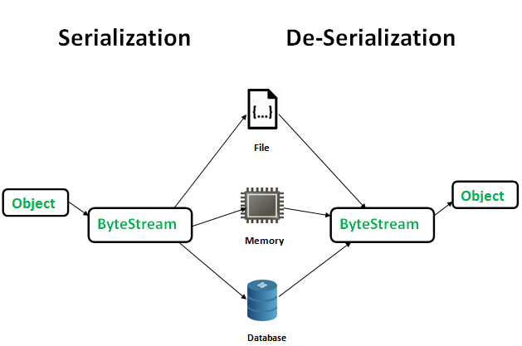
Serialization and Deserialization in Java

Slide 24
Serialization and Deserialization in Java
Serializable is a marker interface (has no data member and method). It is used to "mark" Java classes so that the objects of these classes may get a certain capability.
It must be implemented by the class whose object you want to persist.
Advantages of Java Serialization
It is mainly used to travel object's state on the network (which is known as marshaling).
To save/persist state of an object.

Slide 25
Serialization and Deserialization in Java
POINTS TO REMEMBER
1. If a parent class has implemented Serializable interface then child class doesn’t need to implement it but vice-versa is not true.
2. Only non-static data members are saved via Serialization process.
3. Static data members and transient data members are not saved via Serialization process. So, if you don’t want to save value of a non-static data member then make it transient.
4. Associated objects must be implementing Serializable interface.

Slide 26
object stream classes
The object stream classes :
ObjectInputStream
ObjectOutputStream.
These classes implement ObjectInput and ObjectOutput, which are subinterfaces of DataInput and DataOutput.
Classes ObjectInputStream and ObjectOutputStream are high-level streams that contain the methods for serializing and deserializing an object.
The ObjectOutputStream class is used to write primitive data types, and Java objects to an OutputStream. Only objects that support the java.io.Serializable interface can be written to streams.
The ObjectOutputStream class contains many write methods for writing various data types
public final void writeObject(Object x) throws IOException
The above method serializes an Object and sends it to the output stream.

Slide 27
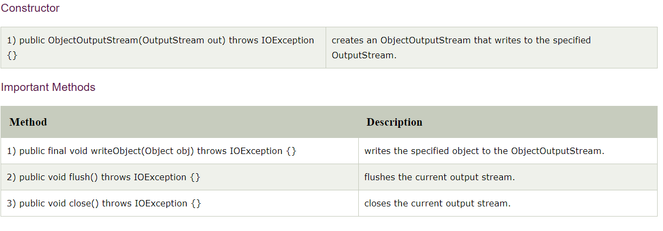
ObjectOutputStream

Slide 28
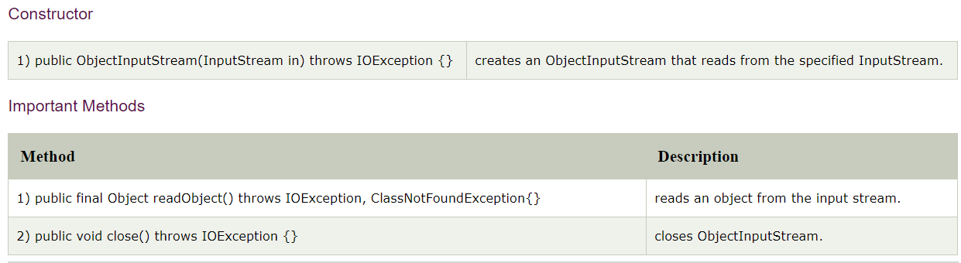
ObjectInputStream class
An ObjectInputStream deserializes objects and primitive data written using an ObjectOutputStream.
ObjectInputStream class contains the following method for deserializing an object −
public final Object readObject() throws IOException, ClassNotFoundException
This method retrieves the next Object out of the stream and deserializes it. The return value is Object, so you will need to cast it to its appropriate data type.

Slide 29
Serialization and Deserialization in Java
import java.io.*;
public class SerializationDemo {
public static void main(String args[]) {
// Object serialization
try {
MyClass object1 = new MyClass("Hello", -7, 2.7e10);
System.out.println("object1: " + object1);
FileOutputStream fos = new FileOutputStream("serial");
ObjectOutputStream oos = new ObjectOutputStream(fos);
oos.writeObject(object1);
oos.flush();
oos.close();
}
catch(IOException e) {
System.out.println("Exception during serialization: " + e);
System.exit(0);
}

Slide 30
Serialization and Deserialization in Java
// Object deserialization
try {
MyClass object2;
FileInputStream fis = new FileInputStream("serial");
ObjectInputStream ois = new ObjectInputStream(fis);
object2 = (MyClass)ois.readObject();
ois.close();
System.out.println("object2: " + object2);
}
catch(Exception e) {
System.out.println("Exception during deserialization: " + e);
System.exit(0);
}
}
}

Slide 31
Serialization and Deserialization in Java
class MyClass implements Serializable {
String s;
int i;
double d;
public MyClass(String s, int i, double d) {
this.s = s;
this.i = i;
this.d = d;
}
public String toString() {
return "s=" + s + "; i=" + i + "; d=" + d;
}
}

Slide 32
Serialization and Deserialization in Java
This program demonstrates that the instance variables of object1 and object2 are identical.
The output is shown here:
object1: s=Hello; i=-7; d=2.7E10
object2: s=Hello; i=-7; d=2.7E10

Slide 33
summary
An interface is a completely "abstract class" that is used to group related methods with empty bodies:
To access the interface methods, the interface must be "implemented" (kinda like inherited) by another class with the implements keyword (instead of extends). The body of the interface method is provided by the "implement" class.
Serialization is the process of writing the state of an object to a byte stream. This is useful when you want to save the state of your program to a persistent storage area, such as a file.

